Slide 1
Maintenance Year 2
Plumbing

Slide 2
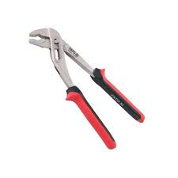
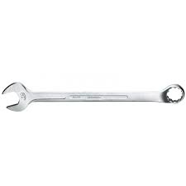
Basic marking cutting hand tools.
1. Water pumps pliers
- It is used for removing and replacing clamps.
2. Spanners
- It is used to for fastening and loosing bolts and nuts.

Slide 3
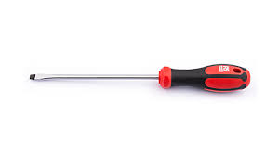
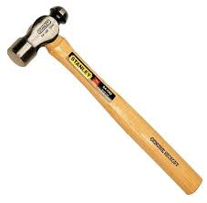
Basic marking cutting, power and hand tools. (continues)
3. Screwdriver
- It is used for fastening and loosing screws.
4. Hammer
- It is used for general hammering.

Slide 4
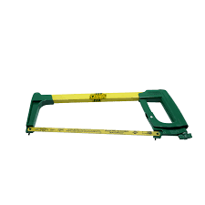
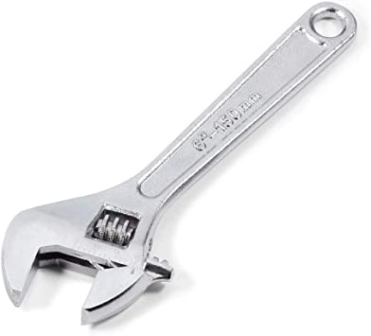
Basic marking cutting hand tools. (cont..)
5. Hacksaw
- It is used for cutting pipes.
6. Shifter
- It is used for fastening and loosening of bolts and nuts.

Slide 5
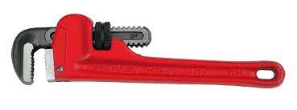
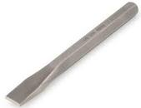
Basic marking cutting hand tools. (cont..)
7. Pipe wrench / Bob Jones
- It is used for fastening and loosening of bolts, nuts and fittings.
8. Chisel
- It is used as a cutting tool..

Slide 6
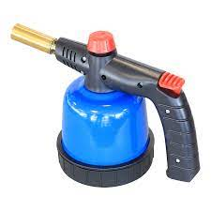
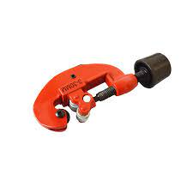
Basic marking cutting hand and power tools. (cont..)
9. Blow torch
- It is used for heating of metals and pipes
10. Pipe cutter
- It is used cutting pipes.

Slide 7
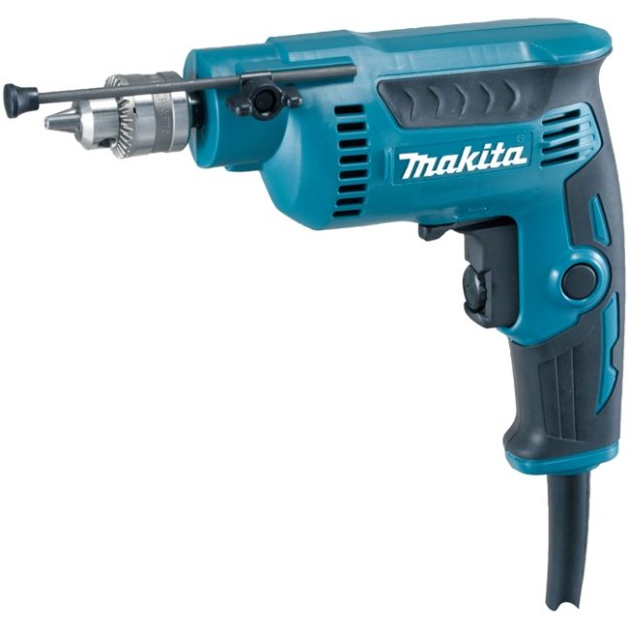
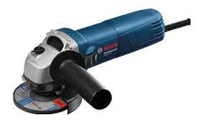
Basic marking cutting and hand tools. (continues)
11. Hand drill
It is used for drilling of materials.
12. Angle grinder
- It is used for cutting and grinding of materials.

Slide 8
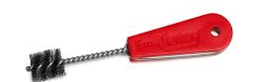
Basic marking cutting, power and hand tools. (continues)
13. Pipe brush
- It is used for cleaning of oxide films.
Feedback
Activity : Worksheet 2

Slide 9


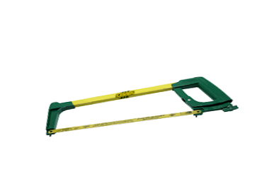

Kwa Thema Skills School
Subject : Maintenance Marks : 10
Grade : Year 2 Time : 30mins
Date :
Question:1
Name the following marking and cutting hand tools.
1.__________________ 2.______________________
3.___________________ 4. ______________________

Slide 10
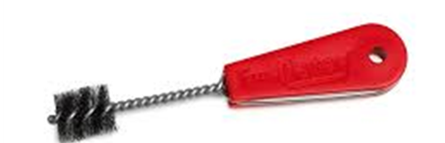
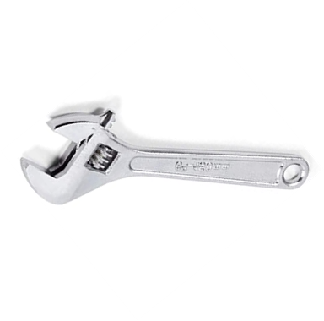




5. _________________ 6. ____________________
7. __________________ 8. ___________________
9. __________________ 10. ___________________
(10)

Slide 11
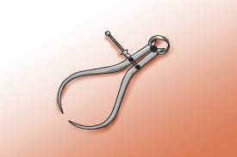
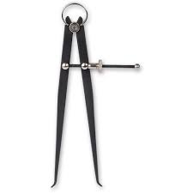
Measuring and Marking of tools
1.Callipers
- There are two types of callipers i.e. inside and outside callipers.
They are use to determine shorter lengths.
Outside calliper.
Inside calliper.

Slide 12
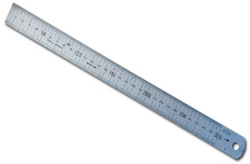
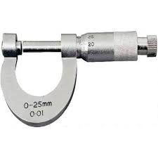

2. Ruler
-It is used to measure lengths.
3. Screw gauge (Micrometer)
-It is used to measure precise small lengths.
4. Measuring tapes.
It is used to measure lengths.

Slide 13
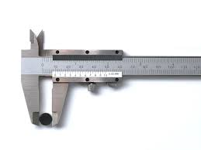


5. Vernier
-It is used to measure lengths.
Feedback
Activity : Worksheet 3
Kwa Thema Skills School
Subject : Maintenance Marks : 10
Grade : Year 2 Time : 30mins
Date :
Question:1
1.Name the following marking and measuring hand tools and its purpose or use.
1.1 Tool:__________________ 2.1 Tool:_______________
1.2 Use:____________________________________ 2.2. Use:___________________________________

Slide 14
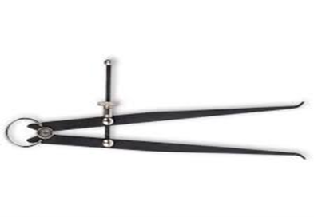

3.1 Tool:__________________ 4.1 Tool:_______________
3.2 Use:____________________________________ 4.2. Use:___________________________________
5.1 Tool:__________________
5.2 Use:____________________________________
(10)

